Slide 1
International Quality Improvement Collaborative (IQIC) for Congenital Heart Surgeries
The AKUH, Pakistan Experience

Slide 2
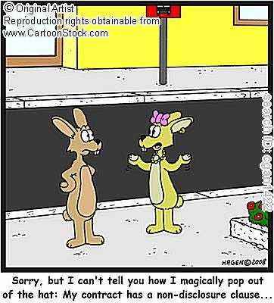
No disclosures
No financial associations.

Slide 3
Aga Khan University Hospital

Slide 4
Aga Khan University Hospital
560-bed teaching hospital located in Karachi, Pakistan.
150-200 patients with congenital heart defects each year undergo surgery

Slide 5
Development of Congenital Heart Program
First closed heart- late 1980s
First open heart and cath lab- 1995
Dedicated Congenital program in 2007 (1 surgeon, 1 cardiologist)
2011-14: 1 surgeon, 4 cardiologist, 3 anasthesia, 2 intensivists
2013- onwards: dedicated nurses

Slide 6
Case volume
ECHO 5000/year
Interventional cath: 300/year
Open Heart Surgeries: 200/year

Slide 7
The Collaboration?
Started in 2013. A team was identified and called “The IQIC team”. Comprised of
Cardiac Surgeon
CICU head nurse and another senior nurse
Intensivist
2 Cardiologists
Primary responsibility of data collection and monitoring was with CICU head nurse, senior nurse and cardiologist

Slide 8
The IQIC Team
L-R first row: Dr Nadeem, Dr Abbas, Dr Muneer, Amina Khan
L-R second row: Ahmed Abdullah, Dr Babar Hassan, Dr Sulaiman Hassan, Tahira Faiz

Slide 9
Where we stood
before enrolling
in IQIC

Slide 10
Age at Surgery 2011 - 2012
<30 days
31days - 1year
>1 year - <18 years
>= 18years
2011
2012

Slide 11
Infections 2011 - 2012

Slide 12
Patient Outcome 2011- 2012
Breakdown as per RACHS
2011
2012

Slide 13
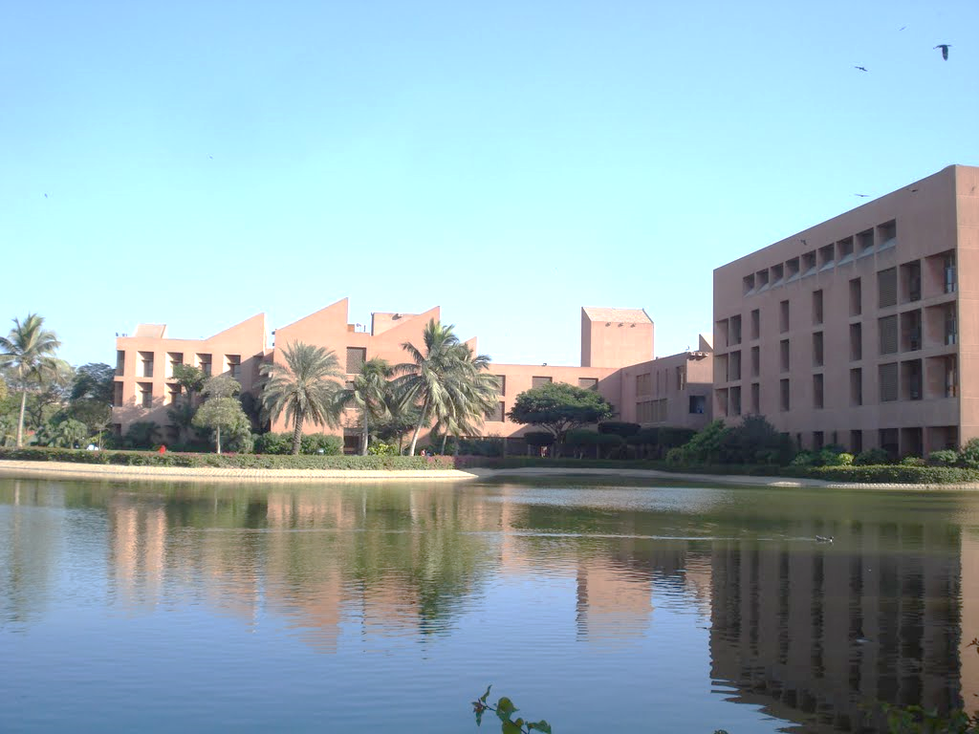
Aga Khan University Hospital
enrolled in IQIC
in January 2013

Slide 14
The Aim Of The Collaboration
Create quality improvement strategies to reduce the major complications.
Reduce perioperative infections
To facilitate distance learning and to disseminate knowledge and skills.
Identify drivers of mortality and create targeted QI strategies to improve surgical outcomes.

Slide 15
The Mission Of The Collaboration
Reduce mortality and
major complications
for children undergoing
Congenital Heart Surgery

Slide 16
Implementation of
IQIC Guidelines in
AKUH, Karachi

Slide 17
Webinar Session

Slide 18
Sterile Suctioning Technique
Two different trained staff performing OETT suctioning of a patient admitted in CICU, to maintain sterility.

Slide 19
CVC Line Handling
Staff following the “CVC Bundle” to prevent line infections, while drawing blood sample from a patient.

Slide 20
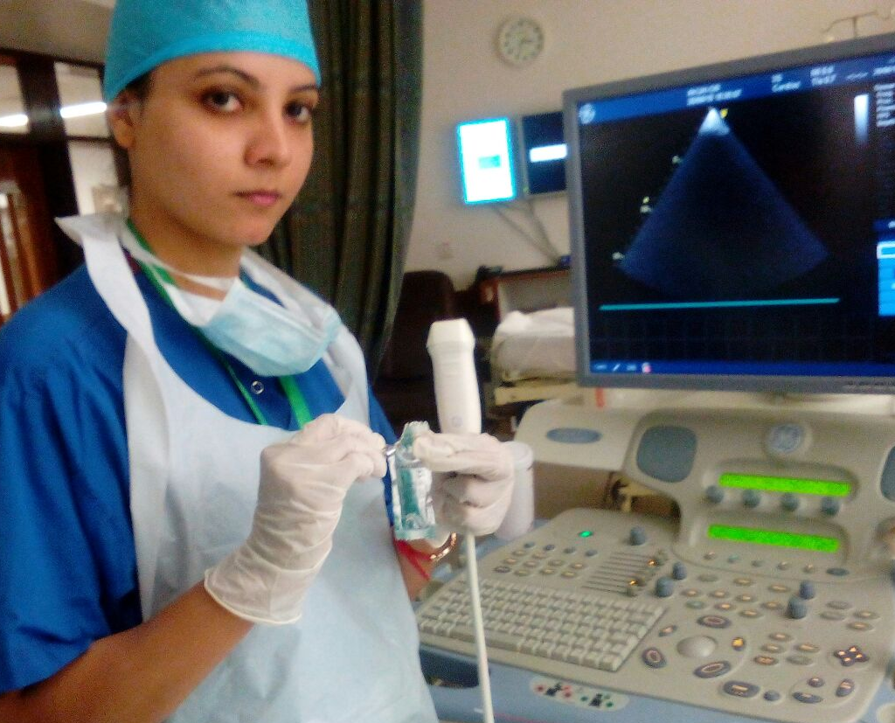
“Sterile/Clean” Echo Techniques
Trained Staff using Hexiprep™ and alcohol swabs to sterilize echo probe before doing echo.
Trained Staff using proper sterile gear and single-use gel for echo to minimize infections.

Slide 21
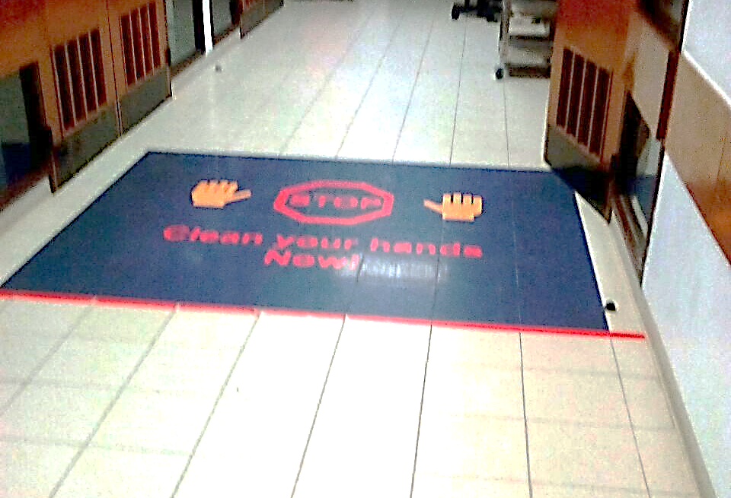
Traffic Control
Sticker placed at entrance of Peads Bays in main entrance area to control traffic flow.
Purell™ installed at all entrances to ensure proper hand hygiene.

Slide 22
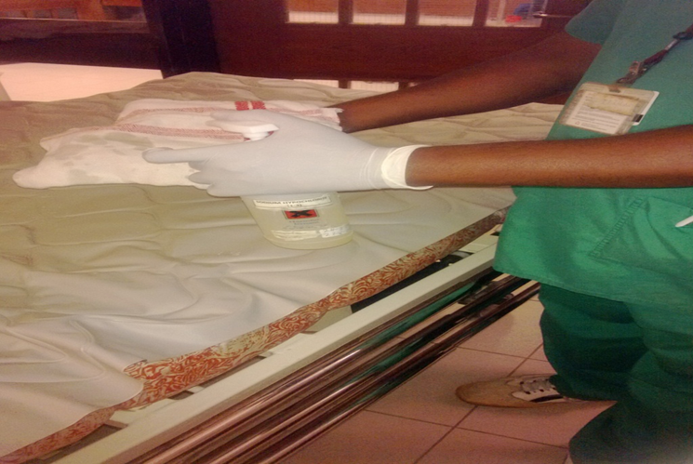
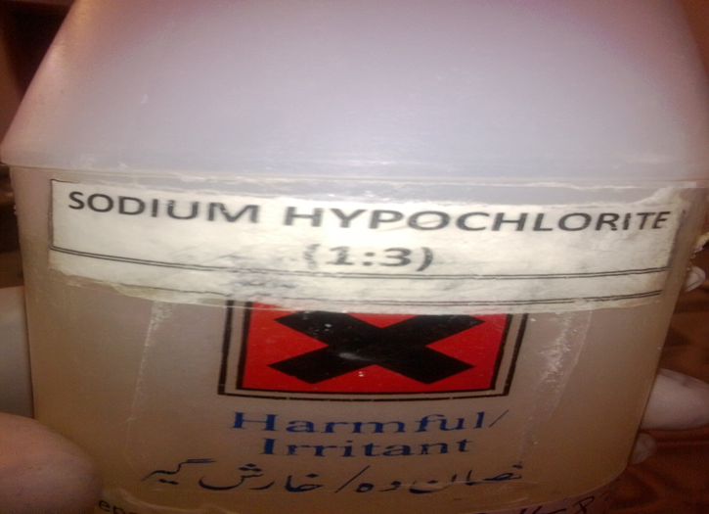
Improved Cleaning Techniques
Solution used to clean instruments changed as per infection control policy.
Improved cleaning techniques being followed to clean patients’ used items.

Slide 23
The Outcomes

Slide 24
Age at Surgery 2013 - 2014
<30 days
31days - 1year
>1 year - <18 years
>= 18years
2013
2014

Slide 25
Patient Outcome 2013- 2014
Breakdown as per RACHS
2013
2014

Slide 26
Infections 2011- 2014

Slide 27
Infections AKU vs Other Sites

Slide 28
Mortality 2011 - 2014

Slide 29
Mortality AKU vs Other Sites

Slide 30
Issues
Intraoperative- non adherence to check list, perfusion related issues, surgeon fatigue/lack of support
Post-operative: poor handover, long response time for patient related queries, improper recognition of patient deterioration.
Skilled staff retention- nurses, trainee doctors

Slide 31
Future Strategies
Projects underway:
Handover in CICU
A quasi-experimental, time lagged control trial evaluating the impact of smart phone/tablet based application on team co-ordination, response time and short-term outcome in post-operative pediatric patients in the cardiac intensive care
Whatsapp based home monitoring program
OR checklist. OR nurse empowerment
PICU conference with session on management dilemma

Slide 32
Strategies cont.
Nurse practitioner program- 5 inducted, curriculum developed
Nurses as clinical researchers/educators
Nurse led rounds
Better pay scale!!!

Slide 33
Acknowledgement
IQIC- especially Chris!!
Surgeons- Muneer Amanullah and Suleiman Hasan
AKUH “IQIC Team”

Slide 34
THANKS!!!!

