Slide 1
Nurse Empowerment: Why and How?
Sandy Staveski PhD, RN, CPNP-AC
Assistant Professor, Nurse Scientist
Research in Patient Services, Heart Institute
Cincinnati Children’s Hospital Medical Center
University of Cincinnati
No disclosures

Slide 2
Definition
Em-pow-er-ment
to give official authority or legal power to
empowered her attorney to act on her behalf
to promote the self-actualization or influence of
women's movement has been inspiring and empowering to women — Ron Hansen

Slide 3
The Future of Nursing: Leading Change, Advancing Health
“…ensure nurses can practice to the full extent of their education and training,
Improve nursing education and training through an improved education system that promotes seamless academic progression,
Provide opportunities for nurses to assume leadership positions and serve as full partners in health care redesign and improvement efforts…”
Institute of Medicine 2011

Slide 4
Essential Components of Nurse Empowerment
Collaborative working relationships
Direct supervisors
Close colleagues
Physicians
Positive professional identity
Professional practice environments
Wang & Liu (2013) found professional practice environments and empowering nurses psychologically increased nurse engagement at work (n=300; 2 tertiary hospitals in Tianjin, China)

Slide 5
What makes nurses feel empowered?
Wahlin and associates (2010) found ICU staff felt empowered by:
Internal processes – feelings of doing good, increased self-esteem/self-confidence, increased knowledge & skills
External processes—nourishing meetings, well-functioning teamwork, good atmosphere

Slide 6
What makes nurses feel empowered?
Professional practice environments
A study of 1104 Chinese nurses reveal 37% experienced high burnout and 54% were dissatisfied with their jobs. (Liu et al., 2012)
Improving nurses' work environments from poor to better was associated with a 50% decrease in job dissatisfaction and a 33% decrease in job-related burnout among nurses. (Liu et al., 2012)
Empowering work conditions will likely result in a personal sense of empowerment. (Spreitzer, 1995)
Confidence, meaningfulness, and feeling of being able to have an impact on the organization

Slide 7
Why is nurse empowerment important for patients?
Positive correlation between nurses’ perceptions of empowerment and patient satisfaction (Donahue et al., 2008)
Can have a positive influence on patient outcomes through: (Laschinger & Finegan, 2005)
Enhanced technical and interpersonal competence
Ability to convey health care information
Quality of care
Hospital acquired infections
Compared with nurses working in poor work environments, nurses working in better work environments were 36% to 41% less likely to report that health care-associated infections occurred frequently (Kelly et al., 2013)

Slide 8
Why is nurse empowerment important for nurses?
It conveys a sense of respect and importance of their role on the interdisciplinary team
Many nurses feel they do not receive respect they deserve in hospital settings (Faulkner & Laschinger, 2008)
Lack of respect has been identified as a key factor affecting quality of nurses work life (Milton, 2005; Laschinger, 2004) and has been shown to be associated with:
Poor job performance
Lower perceptions of quality of care by nurses, physicians, and patients

Slide 9
Why is nurse empowerment important for you?
Expert nurses make life better for all of us!
Experienced nurses provide expert care to our patients
The odds of death increased with an increase in pediatric cardiac ICU nurses with less than 2 years experience – nursing clinical experience was independently associated with mortality (Hickey et al., 2013)
Cultures that empower nurses through supporting autonomy, control over their practice environment, and collaborative relationships can be successful in attracting and retaining nurses

Slide 10
Nurse Empowerment
Nurse empowerment should not be seen as a privilege but as a professional necessity
Move away from hierarchical and authoritarian relationships with nurses
“Nothing about me without me”

Slide 11
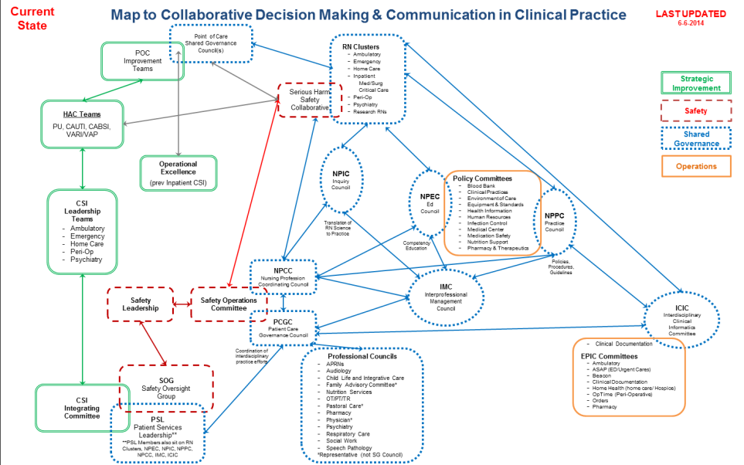

Slide 12
How to empower nurses……
Back to three important elements
Collaborative working relationships
Positive professional identity
Respect
Recognition of the value of their unique contribution
Fair compensation
Professional practice environments
Education and professional development
Ownership of practice

Slide 13
In practical terms
Recognize professional nurses as professional leaders, not just employees
Build a shared team vision amongst the entire team for the value and importance of nursing practice
Support inclusive behaviors and open communication amongst all team members
Create open, focused time for leaders and teams to engage with one another
Adjust down-top changes to fit unit needs and have nurses at the table for important decisions about their practice
Linnen & Rowley 2014

Slide 14
Practical terms and examples
Provide professional development opportunities to empower nurses (and retain them….)
Children’s HeartLink’s BOuNCE Project in Cape Town, South Africa
Demonstrated improvement in the voluntary turnover rates overall, with a high of 35.8% (2006), to the lowest level of turnover, 6.5% (2008)
In spite of modest variation in turnover over time, there was an overall decrease of 47% in nurse turnover from 2006 to 2010

Slide 15
Professional Practice Environment
New Hire
Orientation &
Training
Resource
Development
RN Team
Development
Center of
Excellence
Preceptor
Training
Website
Team
Building
Standards of
Care
Orientation
Program
Handbook
Development
Leadership
Training
Annual
Conference
Novice to
Expert
Skills Fair
Special Roles
Website

Slide 16
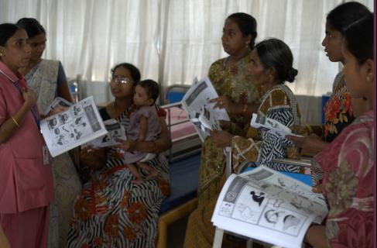
Practical terms and examples
Support nursing ownership of their clinical practice and encourage nurses to practice to it’s fullest extent
Children’s HeartLink - PEDI project

Slide 18
Effects of Empowering Nursing
Innova Children's Heart Hospital Secunderabad, India 800 cases/year
Amrita Institute of Medical Sciences and Research Centre (AIMS) Kochi, India 700 cases/year
First Hospital of Lanzhou University, Lanzhou, China 200 cases/year
Institut Jantung Negara (IJN)/ National Heart Institute Kuala Lumpur, Malaysia 900 cases/year
Narayana Hrudayalaya Hospital Bangalore, India 3000 cases/year
Nhi Dong 1 (Children's Hospital #1) Ho Chi Minh City, Vietnam 300 cases/year
The West China Hospital #1/Sichuan University Chengdu, Sichuan 600 cases/year
Shanghai Children's Medical Center Shanghai, China 2500 cases/year
Hospital do Crianca e Maternidade/Hospital de Base São José do Rio Preto, Brazil 120 cases/year

Slide 19
Looking Forward
Examples of Nurse Practitioner Outcomes:
Reduced ICU length of stay from 4.08 to 3.28 days (p=0.019) and incidence of UTIs (p=0.0001) with use of NPs in adult ICUs
Academic oncologists collaborating with NPs had increased productivity (58 visits/week vs. 51 visits/week), higher efficiency (70% to 92%), more time for complex cases (73% to 87%), and an overall improvement in patient care (69% to 88%)
Gillard et al. (2011); Polansky, Ross, & Coningol (2010)

Slide 20
Leadership to Culture Change – Support for Nurse Empowerment
Promoting key leadership skills for physicians, administrators, and nurses

Slide 21
The Future of Nursing: Leading Change, Advancing Health
"A leader....
Has followers
Has a relationship with them
Guides and goes with them to places they've never been before
If you think you're leading and no one is following you, then you're just out for a walk"
Barry Posner, PhD
Institute of Medicine 2011

Slide 22
Thank you!

