Slide 1
Creating and Sustaining a Healthy Work Environment
Patricia Hickey PhD, MBA, RN, FAAN
Vice President and Associate Chief Nurse
Cardiovascular and Critical Care Services
Boston Children’s Hospital
Assistant Professor of Pediatrics
Harvard Medical School
11th Global Forum on Humanitarian Medicine in Cardiology and Cardiac Surgery
Geneva, Switzerland
June 24th, 2015

Slide 2
“Quantifying the Soft Stuff”

Slide 3
What We Know From the Literature
The work of pediatric clinicians and administrators is:
Altruistic in nature
Intellectually challenging and
Important to patients, staff, and society
Across the globe, people drawn to this work are typically committed to making a critical difference in the lives of patients and families who are vulnerable and often in need of life-saving treatment
The work has become increasingly more complex over the years
Academic teaching hospitals in particular and health care institutions in general are traditional, bureaucratic, and hierarchical
In the United States and Europe, the regulatory burden has grown exponentially, and few hospitals have figured out how to use information technology to reduce that burden

Slide 4
What We Know From the Literature
Nearly 3 in 4 errors are caused by human factors associated with interpersonal interactions
According to one study, more than 50% of health care professionals have witnessed broken rules, mistakes, lack of support, incompetence, poor teamwork, disrespect, and micromanagement

Slide 5
Making the Business Case….. Why organizational health trumps everything else in business

Slide 6
“At the end of the day, when we look back at the many initiatives that we poured ourselves into, few other activities will seem worthy of our effort and more impactful on the lives of others, than making our organizations healthy”
(page 193)

Slide 7
The Price of Poor Health
Financial costs of an unhealthy organization
Wasted resources and time
Decreased productivity
Increased employee turn-off
Customer attrition
Social costs
Loss of interest in work
Pessimistic attitudes
Lower self-esteem

Slide 8
Making the Healthcare Case…..

Slide 9
Background
Human Factors, Leadership, and Communication Issues
Are present in over 60% of ALL sentinel events reported to JCAHO
Percent of 764 Events

Slide 10
Background
In 2006, The American Association of Critical Care Nurses (AACN) and American College of Chest Physicians (ACCP) identified essential standards for establishing and sustaining a healthy work environment
These standards
Align directly with the core competencies for health professionals recommended by the Institute of Medicine
Represent evidence-based and relationship-centered principles of professional performance
Other organizations endorsing Healthy Work Environments: American Thoracic Society, Society for Critical Care Medicine, Society of Hospital Medicine
Notes:
In response to research done regarding the cause of patient errors, in 2005, AACN introduced AACN Standards for Establishing and Sustaining Healthy Work Environments: A Journey to Excellence, which puts forth six essential elements that must be in place for work environments to thrive and contribute to improved patient and system outcomes.
The standards developed by the AACN align directly with the core competencies for health professionals recommended by the Institute of Medicine.
Non-nursing organizations endorsing Healthy Work Environments: American College of Chest Physicians, American Thoracic Society, Society for Critical Care Medicine, Society of Hospital Medicine.

Slide 11
AACN Healthy Work Environment Model

Slide 12
“Finding the good”…..
Unit and Program Examples

Slide 13
AACN Healthy Work Environment Standards
Evidence-Based Standards
Skilled Communication | Administrators, Nurses, and Physicians must be as proficient in communication skills as they are in clinical skills
True Collaboration | Administrators, Nurses, and Physicians must be relentless in pursuing and fostering true collaboration
Effective Decision Making | Administrators, Nurses, and Physicians must be valued and committed partners in making policy, directing and evaluating clinical care and leading organizational operations
Appropriate Staffing | Staffing must ensure the effective match between patient needs and nurse competencies
Meaningful Recognition | Administrators, Nurses, and Physicians must be recognized and must recognize others for the value each brings to the work of the organization
Authentic Leadership | Leaders must fully embrace the imperative of a healthy work environment, authentically live it and engage others in its achievement
Each standard interacts in a dynamic way to promote clinical and operational excellence for optimal patient outcomes

Slide 14
Healthy Work Environment Assessment
AACN launched the HWE assessment validated instrument in November 2009
Electronic survey provides a quantitative assessment based on the six domains of the healthy work environment framework
Survey offers an aggregate score of the six domains, and then individual score for three items within the domain
At Boston Children’s: electronically mailed in 2010, 2013 and 2014
Survey was opened for a period of one month
Two weeks after the original invitation a reminder was sent electronically
All participants responded directly to the AACN website
All responses were anonymous
Interdisciplinary (RN, MD, administrative) staff were invited to complete the survey
Notes:
All participants responded directly to the AACN website.
All responses were anonymous.
Survey open for a period of one month.

Slide 15
Summary Scores Across Cardiovascular Units
1.00 - 2.99: Needs Improvement. 3.00 - 3.99: Good. 4.00 - 5.00: Excellent
*2014 response rates are approximate until final counts are established
Notes:
All participants responded directly to the AACN website.
All responses were anonymous.
Survey open for a period of one month.

Slide 16
Initiatives in Progress
Unit | Targeted Initiative
Across the Cardiovascular Program | Daily healthy work environment survey was implemented to provide staff with real-time identification of issues and problem-solving sessions
Cardiac ICU | Have a nurses week celebration that consists of every day and shift that week Established a Sunshine fund to remember staff during a difficult time such as illness, surgery, or loss of a close family member
Acute Care Cardiac Unit | Continue to promote Way to Shine acknowledgement Development of the Brightest star awarded on a quarterly basis Week of Staff appreciation in September consisting of daily thank you’s, meals for staff and a gift (water bottles)
CVOR | A director of nursing patient services for the CVOR and CICU was appointed in January 2013 Permanent charge nurse model was implemented in March 2013 Implemented new perfusion scheduling and on-call strategies in May 2013 First nursing science fellow appointed from cardiac OR in October 2013

Slide 17
Meaningful Recognition

Slide 18
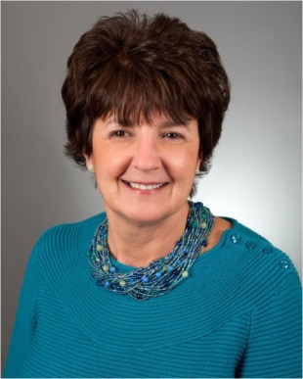
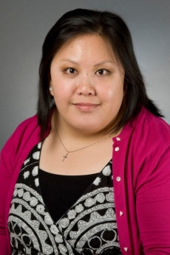
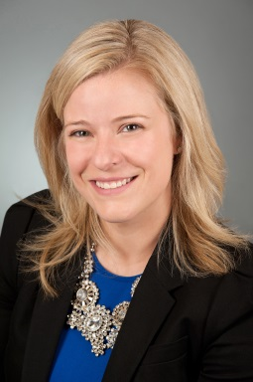
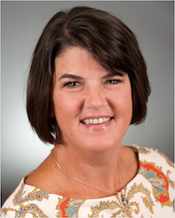
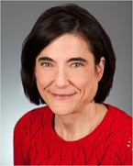
Meaningful Recognition
Employee of the Month
February 2012: Kate Anastasio-Becla Staff Nurse II Medical- Surgical ICU | February 2014: Debra Morrow Staff Nurse III Cardiac ICU
July 2012: Trang Tran Medical Team Assistant Acute Care Cardiac Unit | June 2014: Jenna Murray Nurse Practitioner Ambulatory Cardiology
October 2013: Janet McGillicuddy Patient Services Administrator II Acute Care Cardiac Unit | January 2015: Maria Martuscello Pacemaker/ICD Nurse Ambulatory Cardiology
Notes:
December 2011: Lisa Pixley, Inpatient Staff Nurse II, MSICU
July 2011: Ligia Jordao, Staff Nurse II, Outpatient Cardiology
October 2008: Geraldine Mitchell, Clinical Assistant, Cardiac Operating Room

Slide 19
Meaningful Recognition
Way to Shine Bulletin Board

Slide 20
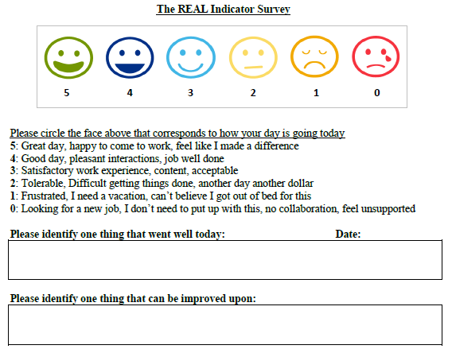
Targeted Initiative in Cardiac Catheterization Lab
Daily Healthy Work Environment Survey: REAL Indicator

Slide 21
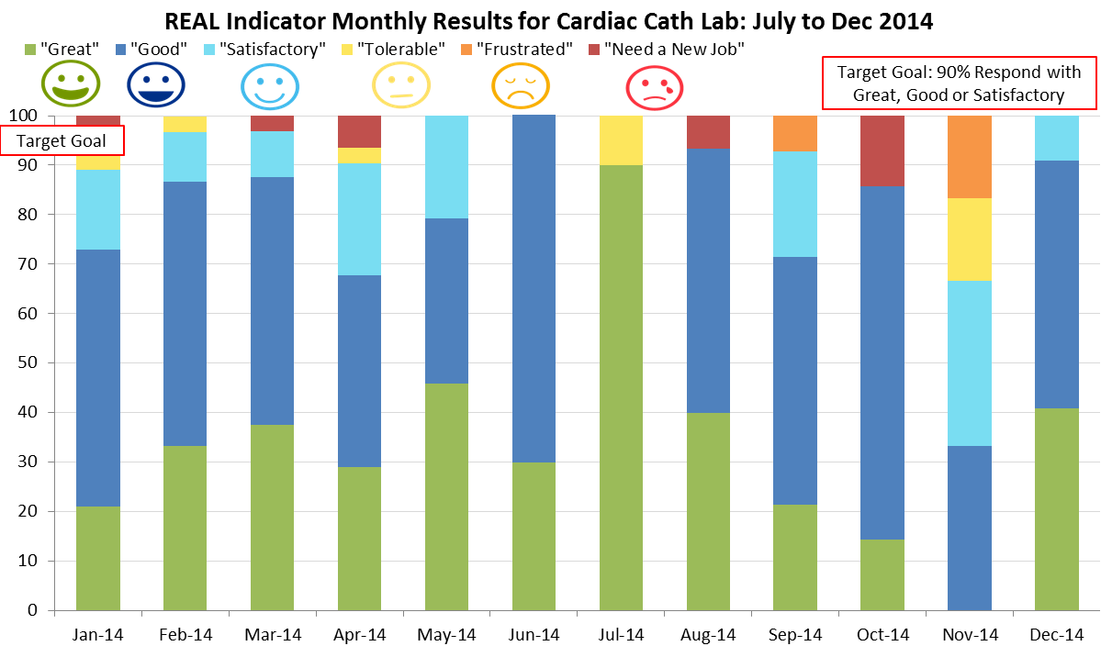
Targeted Initiative in Cardiac Catheterization Lab

Slide 22
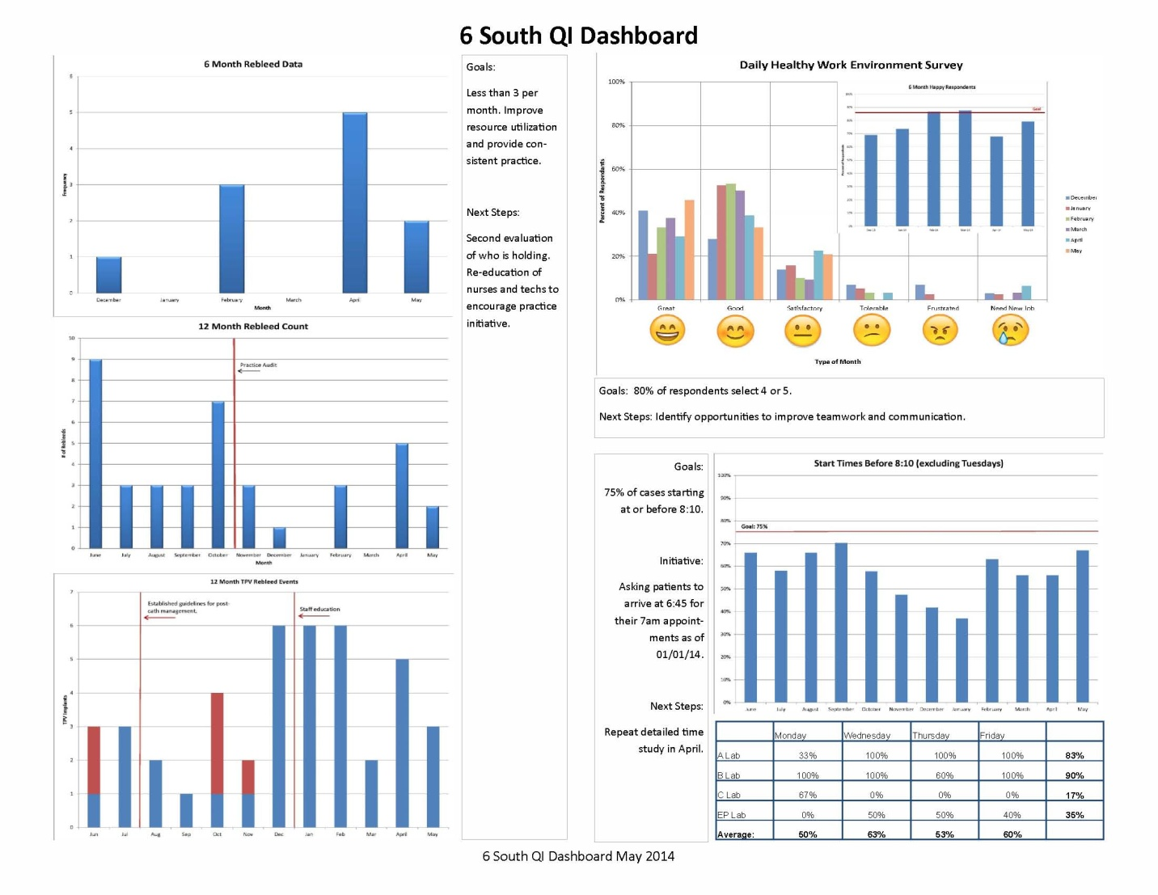
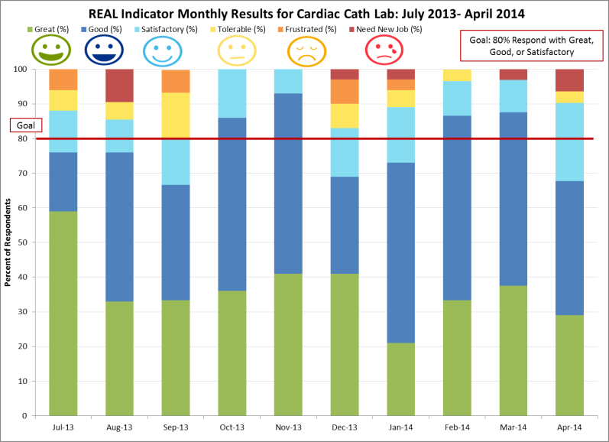
Targeted Initiative in Cardiac Catheterization Lab
Cardiac Catheterization Lab QI Dashboard – May 2014

Slide 23
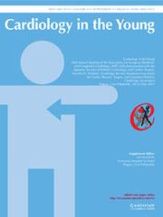
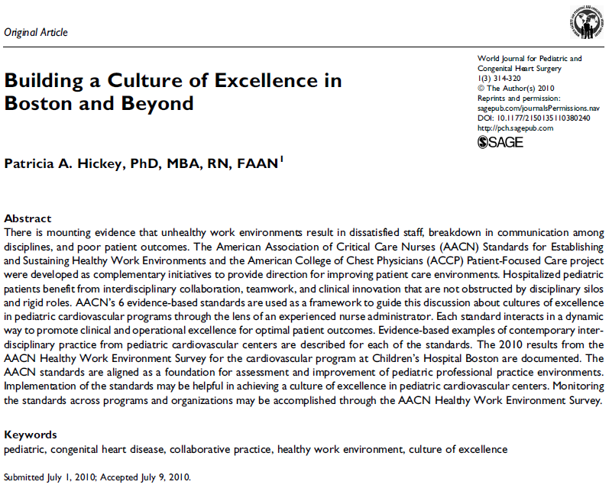
Healthy Work Environment Dissemination
Coming Soon: Monitoring the Health of the Work Environment with a
Daily Assessment Tool: The REAL Indicator
2010

Slide 24
Summary
Maintaining a culture of health in the work environment is critical to ensuring optimal patient outcomes
Maintaining and sustaining a healthy work environment is a continuous process and an activity for which all Boston Children’s clinicians and staff are accountable

Slide 26
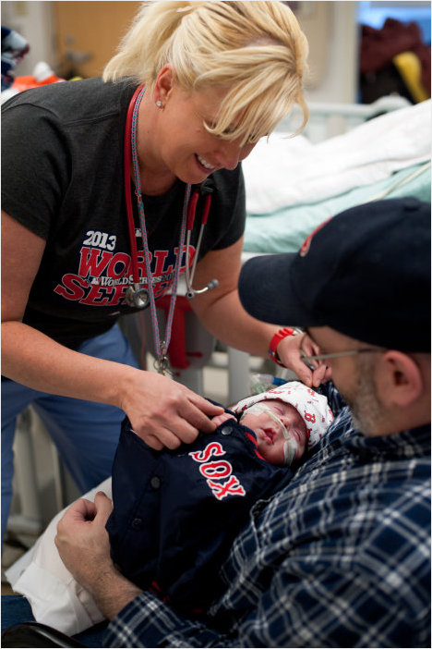
Thank You!

