Slide 1
Perioperative non-medical treatment benefits children’s mid-term outcome
Zhaohui Lu, M.D.
Shanghai children’s medical center(SCMC)
Shanghai, China

Slide 2
Brief introduction of SCMC
Focus on non-medical treatment
How to supply
Outcome and effect

Slide 3
Brief introduction of SCMC
Outcome and effect
How to supply
Focus on non-medical treatment

Slide 4
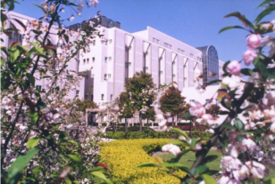
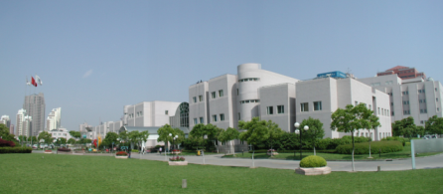
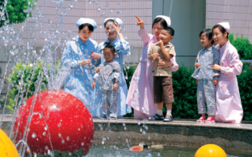
Basic Information of SCMC
A floor space of 73,000 M²
1900 staff
600 medical beds
Offer service to children within 18 years

Slide 5
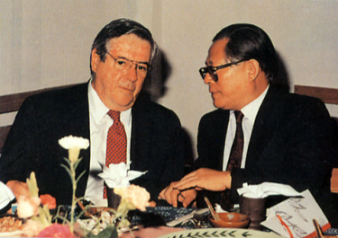
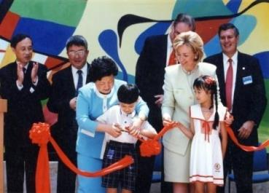
Historical Background
On June 30, 1998, Ms. Hilary Clinton, wife of US president Mr. Bill Clinton, and Ms. Zuo Huanchen, vice mayor of Shanghai, cut the ribbon for the opening of the hospital
In 1988, Jiang Zemin, Shanghai Mayor, met with Dr. W. Walsh, CEO of US based Project HOPE and they discussed the construction program of SCMC

Slide 6

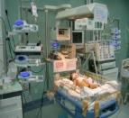
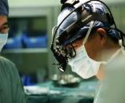
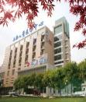
Key Specialty I
  Cardiology and Cardiothoracic Surgery
  Open heart surgery number: 3,700/year
  Cardiac catheterization cases: 1,500/year
  Complicated CHD>55%, Successful Rate>97%
  The smallest age of infant who received surgery : 6 h after birth
  The lowest weight of infant who received surgery : 0.4 Kg
  The only one National Continuous Training Center for Pediatric CHD’S Diagnosis and Interventional therapy

Slide 7
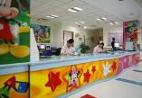
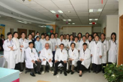

Key Specialty II
  Hematology and Oncology：
  The pioneer Hematology/Oncology Discipline established in China
  New inpatients: 500/year, Outpatients: 20,000/year
  BMT cases: 150/year，Total number: 800
  SCMC-2005 ALL Therapy was selected by National Health Ministry as the guidance among children’s hospitals in China.
  The largest medical center on treatment of leukemia in China
  SCMC-SJCRH Children’s Cancer Center, cooperating with St. Jude Children’s Research Hospital

Slide 8
Brief introduction of SCMC
Focus on non-medical treatment
How to supply
Outcome and effect

Slide 9
Financial support requirement
Mental psychological requirement
Follow-up requirement

Slide 10
Brief introduction of SCMC
Focus on non-medical treatment
How to supply
Outcome and effect

Slide 11
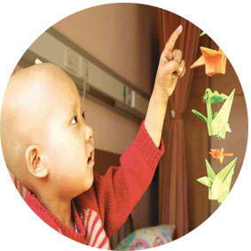
Social worker involvement
ICU parents’ group
Family with cancer patient group
Group
Special cases
Case
Social Work
Fund
Raising fund for our patients
Community
Administration
Children’s Festival
Medical Education for parents
Paper work etc.
Supervision in social work
6 proffeesinal social workers and a stable volunteer team
19 Projects of Special Program

Slide 12
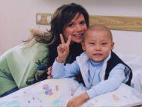
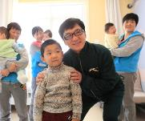
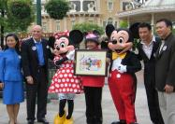
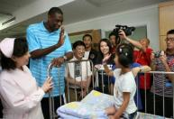
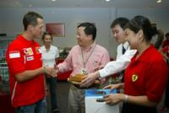
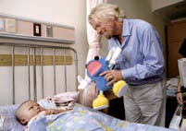
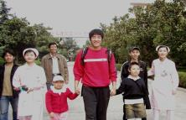
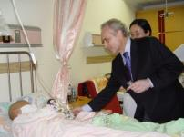
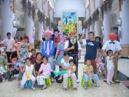
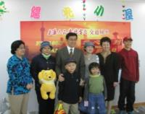
Social worker involvement

Slide 13
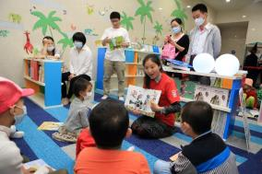
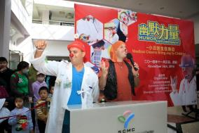
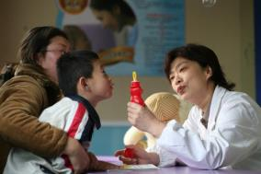
Continuous Improvement motivated by JCI
  Sedation and resuscitation outpatient
  No-cry plan in operation room
  Medical clown training program
  Accompanying reading plan

Slide 14
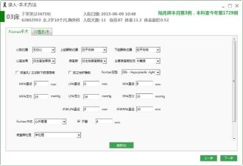
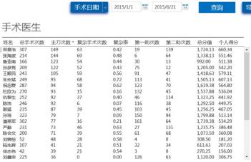
Overall quality control
  Reconstruct HIS collaborated with MicroSoft
  Clinical Data Repository (CDR) framework
  Specialty-specific electronic medical record construction
  Real time quantitative analysis and quality control
  Follow up and satisfactory survey through APP

Slide 15
Overview of CDR

Slide 16
Brief introduction of SCMC
Focus on non-medical treatment
How to supply
Outcome and effect

Slide 17
  More than 1000 children benefited in 2014，totally more than 6000 cases in the past 10 years
  Safety guarantee measures strengthened
  Mortality and hospital infection incidence keep in low level
Raise funding
In 2014
400million
Enterprise
16%
personal
5%
NGO
79%

Slide 19
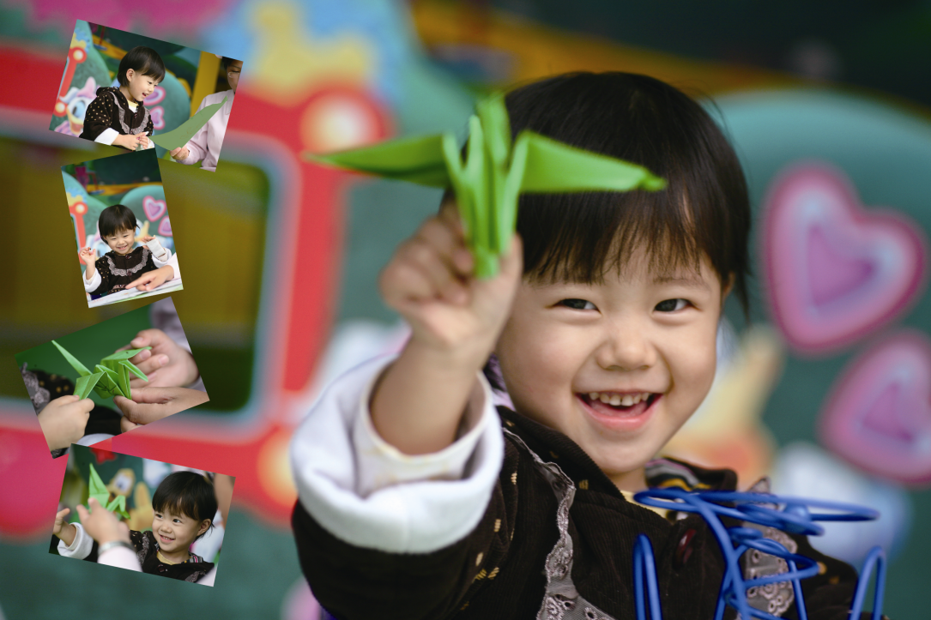
Thanks！
Notes:
On behalf of Shanghai Children’s Medical Center, I would like to express my warmly welcome and sincere appreciation for bbbbbb come to our hospital.

